Slide 1

A Statistical Approach to Analyze Renewable Energy
Vittal Siddaiah

Slide 2
Introduction
Increasing demand of up to 5% of energy
Increasing rate of Pollution
Decreasing fossil fuel reserves
Increasing concerns in disposal of waste…
Is there any energy that can be produced with minimal or low impact on environment ?
Wind Energy
Solar Energy

Slide 3
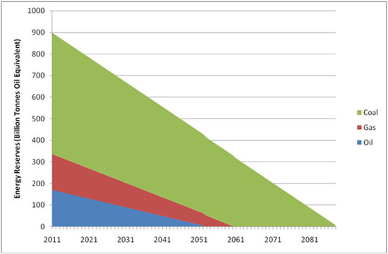
Rate of Energy Reserve Depletion
Ref https://www.ecotricity.co.uk/our-green-energy/energy-independence/the-end-of-fossil-fuels

Slide 4
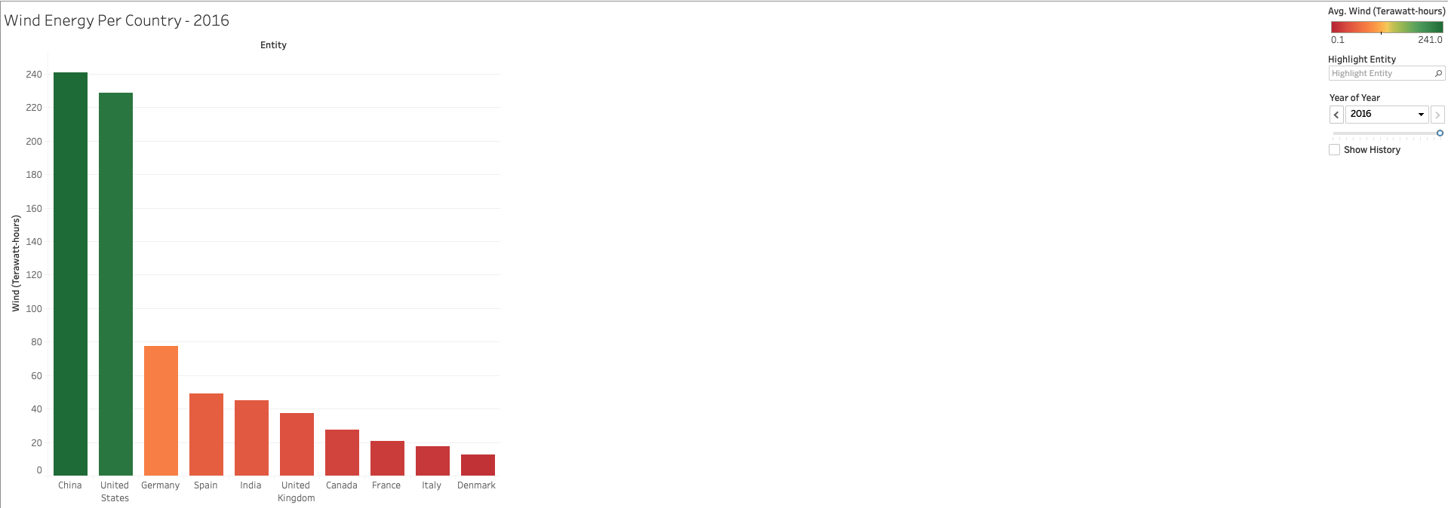
Wind Energy Consumed by Country

Slide 5
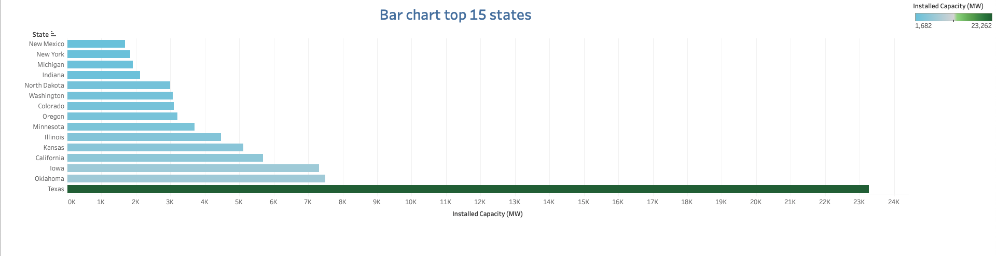
States in US using Wind Energy

Slide 6
Wind Speed
Wind speed is the source for wind power generation
If we can model and prediction wind speed, we can forecast the potential wind power that could be generated
Our Goal is to model and predict wind speed…

Slide 7
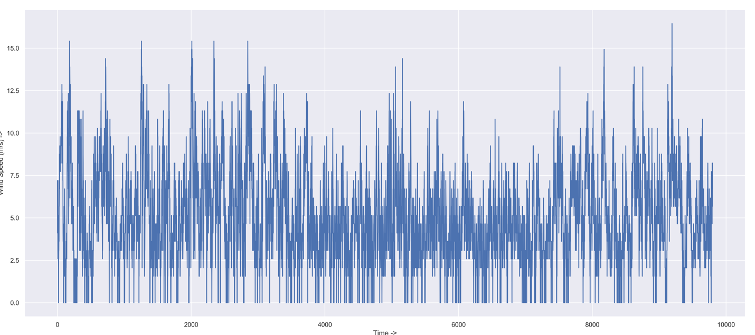
Wind Speed Modelling
Wind Speed – A Time Series Data
We see a pattern and cannot define it, we called it a random pattern
and when we cannot recognize a pattern we called it a garbage …

Slide 8
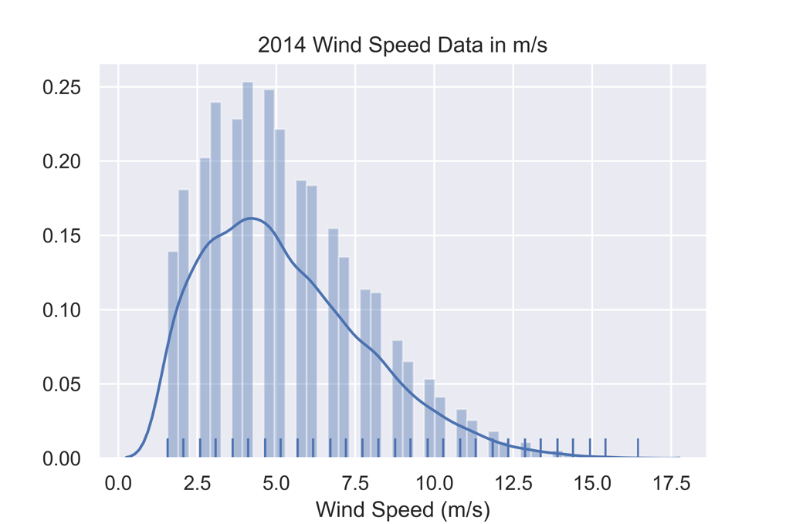
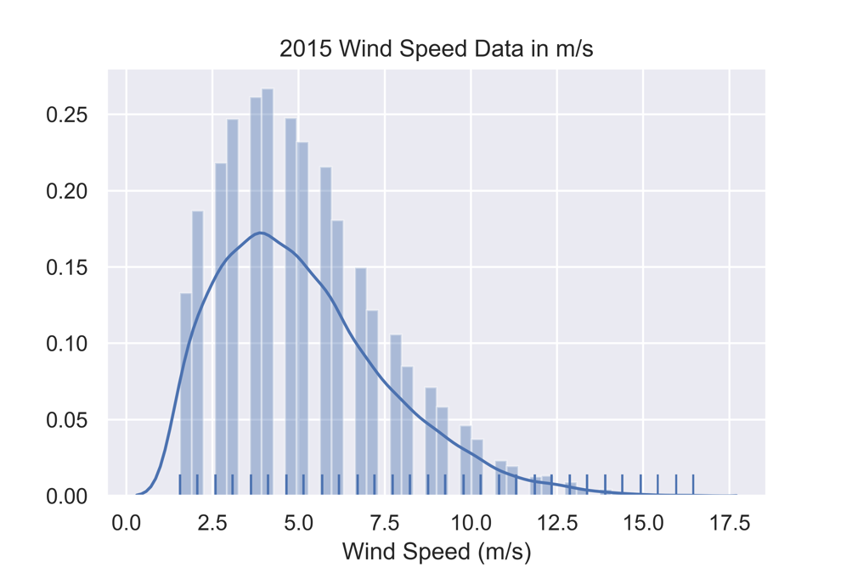
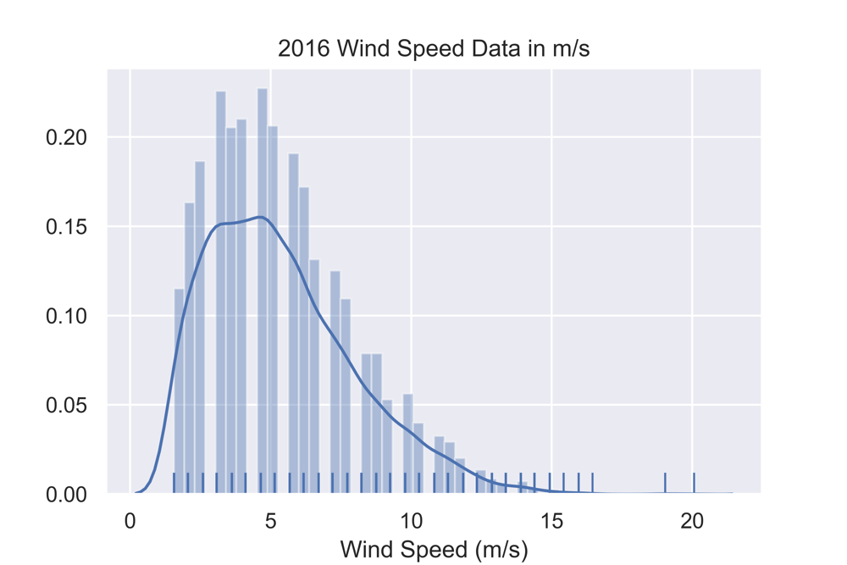
Transformation of Data
Transform the data from Time Domain to Frequency Domain
Unexplored opportunity value of data

Slide 9
Predictive Modelling
Prediction is power!, “Predictive modelling is the process by which a model is created or chosen to try to best predict the probability of an outcome”. Predictive Models are agile for the current market dynamics. The base for predictive modelling are:
Data
Algorithms
The efficacy of any model would be rated by the proximity to the actual system pattern.

Slide 10
How to Predict
Model Predicted with least errors
Model Predicted and defined as Fit Parameters
Algorithms to Predict the Behavior
Data
Validate The Fit
Bias and Prediction Methodology

Slide 11
Parametric Estimation for Wind Speed
Model Predicted from Algorithms
2014 Parametric Estimation:
Shape Parameter / k = 2.1994148897531423
Scale Parameter / Lambda = 6.000595719197021
2015 Parametric Estimation:
Shape Parameter / k = 2.220278964200095
Scale Parameter / Lambda = 5.80273306542091
2016 Parametric Estimation:
Shape Parameter / k = 2.171341999587767
Scale Parameter / Lambda = 6.081850251796716
#Python Source Code Snippet
#################################################################################
def WeiBullFit(csvFile, label):
df = pd.read_csv(csvFile)
#Data Formatting Phase
windSpeed = pd.to_numeric(df['Wind Speed (m/s)'], errors='coerce')
#Data Cleaning Phase
cleanedData = windSpeed.dropna()
cleanedData = cleanedData[cleanedData >0]
shapeFactor, loc, scaleFactor = weibull_min.fit(cleanedData , floc=0)
print(label + " Parametric Estimation: ")
print("\tShape Parameter / k = ", shapeFactor)
print("\tScale Parameter / Lambda = ", scaleFactor)
return [shapeFactor, scaleFactor]
#################################################################################
WeiBullFit("./NYW_2014.csv", "2014")
WeiBullFit("./NYW_2015.csv", "2015")
WeiBullFit("./NYW_2016.csv", "2016")
#################################################################################

Slide 12
Validating the Predicted Model
Predicted Model Consistency in distribution

Slide 13
Machine Learning
Future work …
Creating an public open source application that can accurately predict
Wind Speed
Potential Power that could be generated
Machine Learning
Using Supervised Learning on past data
Un Supervised Learning to explore the patterns.

Slide 14
Stay tuned for the upcoming site…

